Slide 1
Lesson objective
Title: Trapeziums
Aim:
Identify perpendicular heights
Calculate the area of trapeziums
Plan:
Review perimeter and area of common shapes
Perpendicular heights
Trapeziums

Slide 2
Key features
Circumference
Circle edge/perimeter
Radius
From center of the circle to outside edge
Diameter
Straight line through the center, edge to edge
Diameter is twice the length of its radius

Slide 3
Circles refresh
Find the area and circumference.
Exercise books!
22cm
18cm

Slide 4
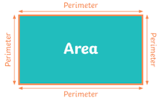
Perimeter
Perimeter – the distance around the outside of a shape.
Area – the amount of space taken up by a 2D shape.
Area

Slide 5

Answers:
132cm² and 46cm
150cm² and 46cm
160cm² and 44cm
1
12cm
11cm
Find the area and perimeter of these shapes.
2
10cm
8cm
15cm
3
14cm
10cm
16cm

Slide 6
Base and height are always perpendicular to each other
Perpendicular – “at right angles to”
Height and base MUST be Perpendicular!

Slide 7

Area of Triangles
Area =$\frac{base × height}{2}=\frac{1}{2}×base×height=0.5×base×height=0.5bh$
base
height
height
height
base
base

Slide 8



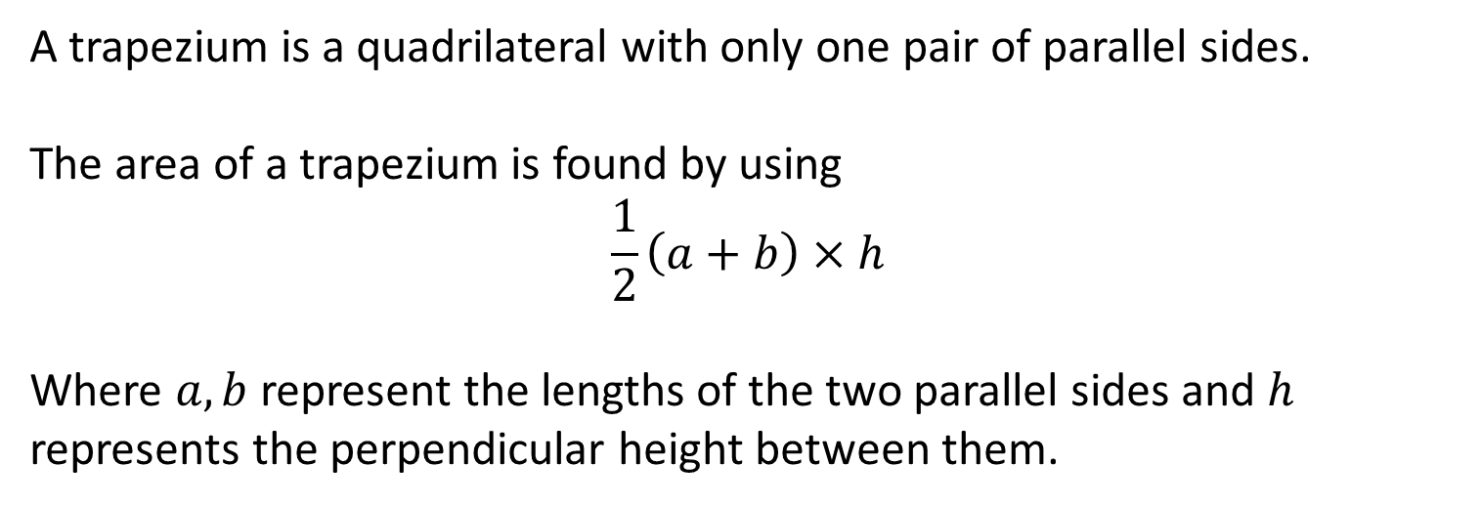






Area of a trapezium
A trapezium is a quadrilateral with only one pair of parallel sides.
The area of a trapezium is found by using
$$\frac{1}{2}\left(a+b\right)×h$$
Where $a,b$ represent the lengths of the two parallel sides and $h$ represents the perpendicular height between them.
This is on our notes page!
$$a$$
$$a$$
$$h$$
$$h$$
$$b$$
$$a$$
$$b$$
$$h$$
$$b$$

Slide 9





Area of a trapezium - example
Find the area of the trapezium below
Identify perpendicular heights
$$12cm$$
Substitute in
$$8cm$$
$$7cm$$
$$2cm$$
$$6cm$$

Slide 10





Area of a trapezium - practice
Find the area of the trapezium below.
Identify perpendicular heights
$$4cm$$
$$14cm$$
$$9cm$$
$$8cm$$
$$16cm$$

Slide 11
Practice task
Area of trapeziums

